Slide 1




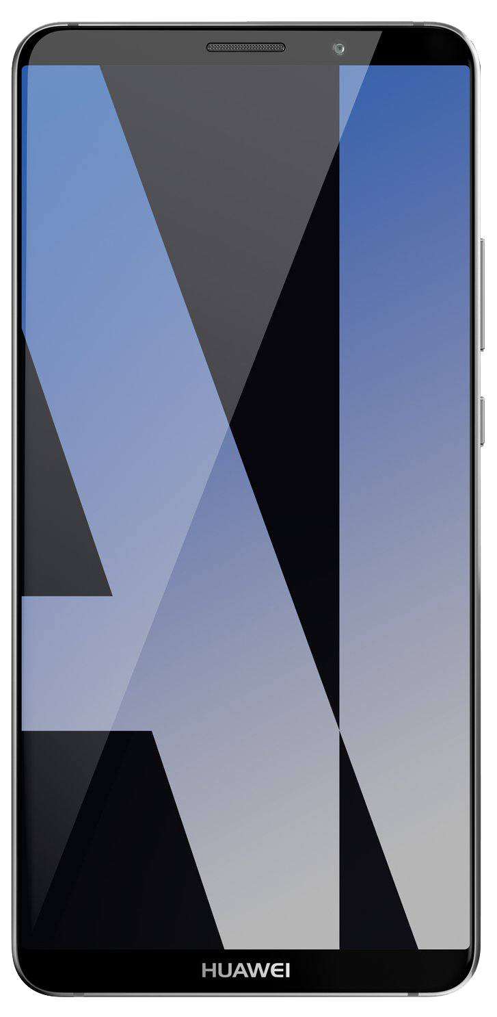

Microsoft advancement in AI capability
96%
RESNET vision test 152 layers
5.1%
Switchboard speech recognition test
88.493%
SQuAD reading comprehension test
69.9%
MT research system
Switchboard
Meeting speech
Object recognition
Human parity
2016
Broadcast speech
Switchboard cellular
Speech recognition
Human parity
2017
Machine reading comprehension
Human parity
Jan 2018
Machine translation
Human parity
March 2018
IBM Switchboard
1993
2000
2006
2010
2017

Slide 2
AI transformation
Digital agents
Transform your engagement with customers and employees
Intelligent apps
Leverage AI to create the future business applications
Business processes
Transform critical business processes with AI
AI platform
Infusing AI
Business solutions
Microsoft AI

Slide 3
Data Platform

Slide 4

Big Data & Advanced Analytics at a glance
Ingest
Store
Prep & Train
Model & Serve
Intelligence
Business apps
Data Factory
(Data movement, pipelines & orchestration)
Cosmos DB
Predictive apps
Blobs
Data Lake
Databricks
HDInsight
Data Lake Analytics
SQL
Custom apps
Kafka
10 01
SQL Database
SQL Data Warehouse
Operational reports
Event Hub
IoT Hub
Machine Learning
Sensors and devices
Analysis Services
Analytical dashboards
Notes:
Azure build-out of DMSA. Supports hybrid\on-premises too through ADF \ Blob \ Stretch.

Slide 5
Microsoft AI

Slide 6
Microsoft AI Platform
Azure AI Services
Tools
PRE-BUILT AI
CONVERSATIONAL AI
CUSTOM AI
CODING & MANAGEMENT TOOLS
Cognitive Services
Bot Service
Azure Machine Learning
VS Tools for AI
Azure ML Studio
Azure ML Workbench
Others (PyCharm, Jupyter Notebooks…)
Azure Infrastructure
DEEP LEARNING FRAMEWORKS
AI ON DATA
AI COMPUTE
3rd Party
Cosmos DB
SQL
DB
SQL
DW
Data Lake
Spark
DSVM
Batch AI
ACS
IoT Edge
Cognitive Toolkit
TensorFlow
Caffe
CPU, FPGA, GPU
Others (Scikit-learn, MXNet, Keras, Chainer, Gluon…)

Slide 7
Azure machine learning service

Slide 8
Machine Learning Pipeline

Slide 9
Ci/cd ml/ai

Slide 10
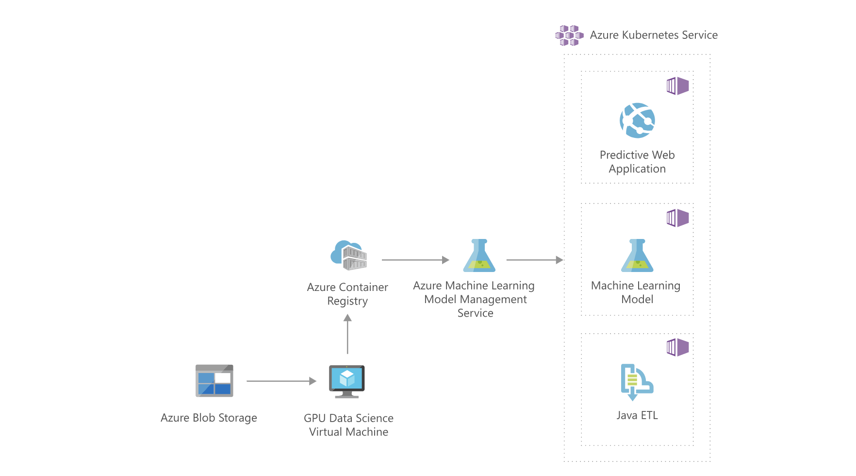
Reference architecture

